Slide 1
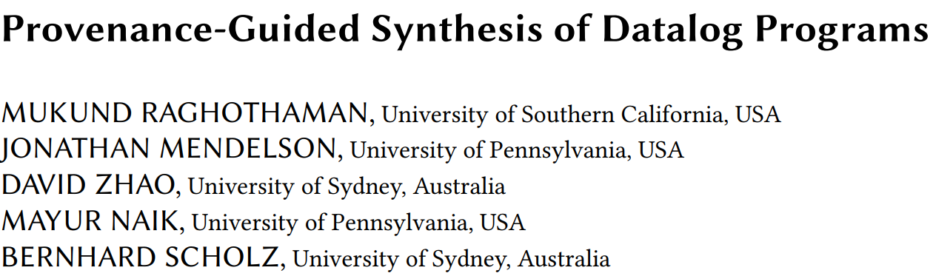

Slide 2
Motivating example
Strongly connected components in a directed graph
Formulated as syntax-guided synthesis (SyGus) problem
Semantic specification: relational I/O examples
Syntactic specification: candidate rules (set of possible Horn clauses)

Slide 3
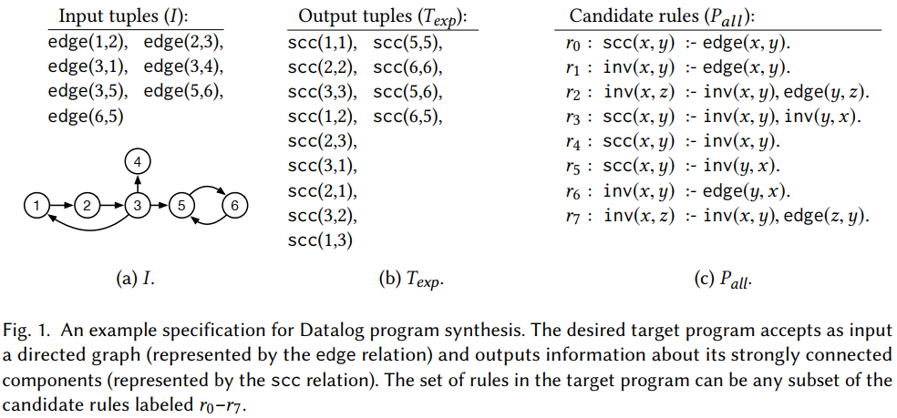
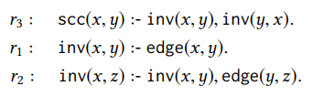


Motivating example

Slide 4
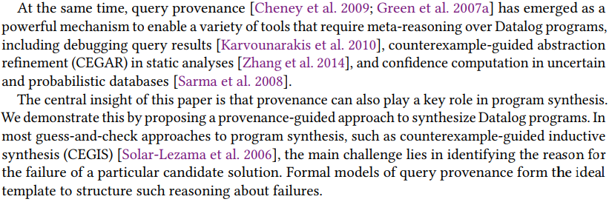
Motivation

Slide 5
Method
Our approach leverages query provenance to scale the counterexample-guided inductive synthesis (CEGIS) procedure for program synthesis. In each iteration of the procedure, a SAT solver proposes a candidate Datalog program, and a Datalog solver evaluates the proposed program to determine whether it meets the desired specification. Failure to satisfy the specification results in additional constraints to the SAT solver.

Slide 6
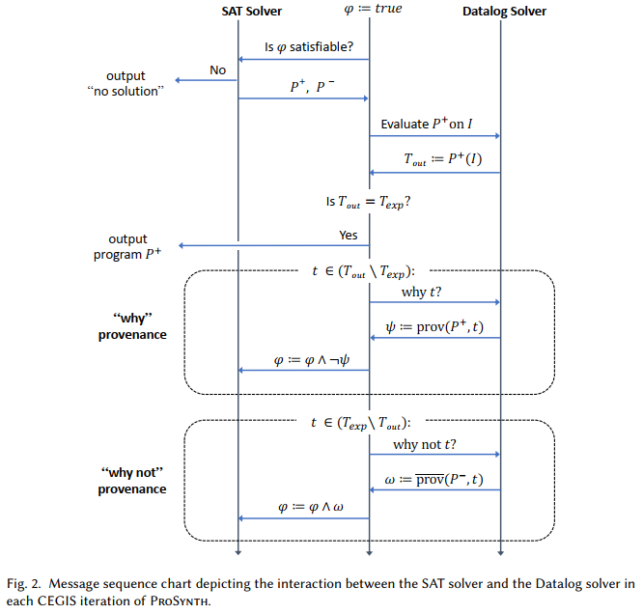
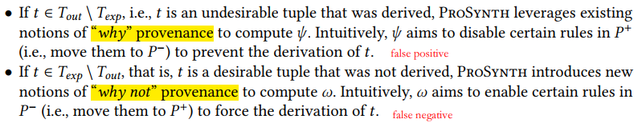

Slide 7
Method
We develop a general framework to harness provenance information from the Datalog solver to learn the constraints to the SAT solver in each CEGIS iteration.

Slide 8
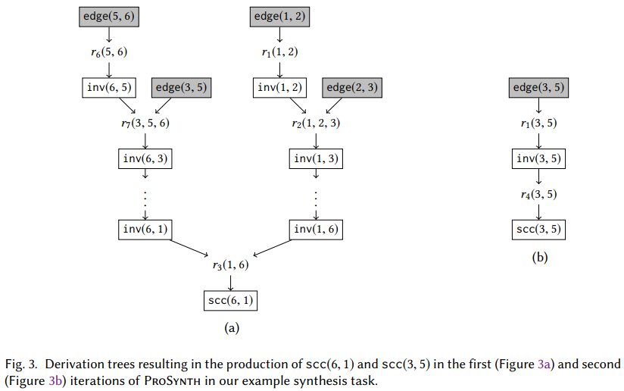
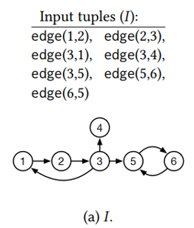
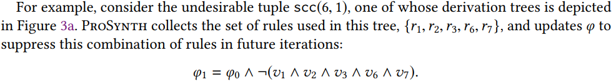
Provenance-guided synthesis (why-provenance)

Slide 9
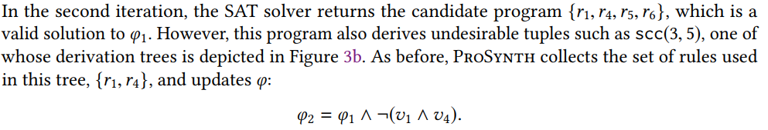
Provenance-guided synthesis (why-provenance)

Slide 10
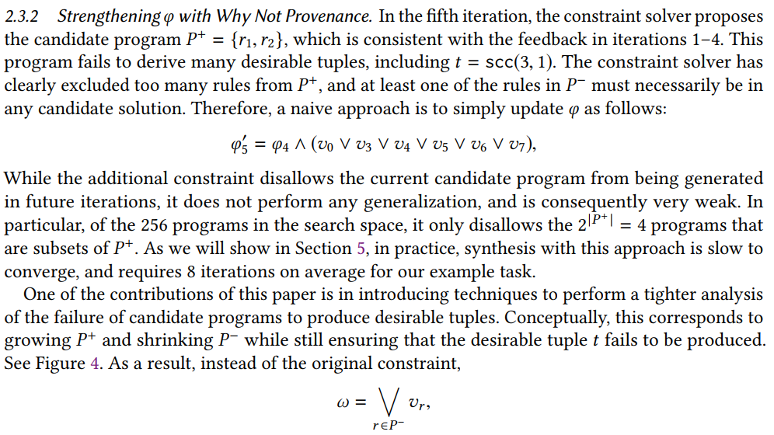
Provenance-guided synthesis (why not-provenance)

Slide 11
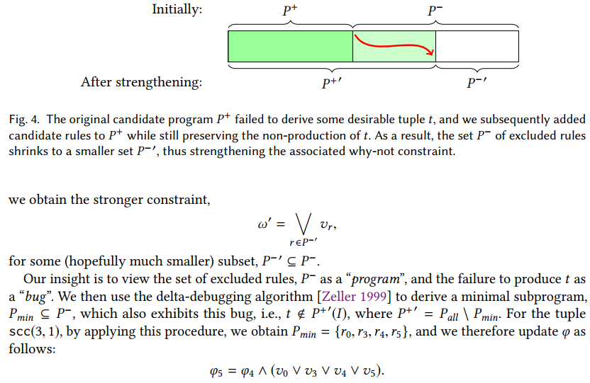
Provenance-guided synthesis (why not-provenance)

Slide 12
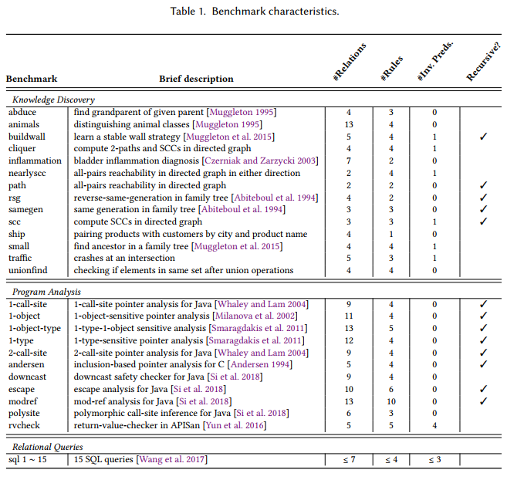
Evaluation

Slide 13
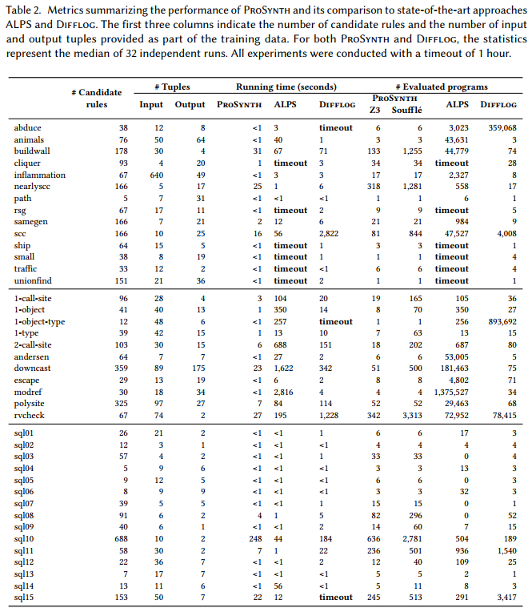
Evaluation

Slide 14
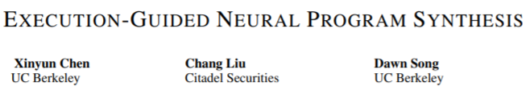
Related work

